Slide 1
Mass and Momentum Equations
A. Bateman
Notes:
1

Slide 2
Ecuaciones
Mass Conservation
Energy Conservation
Momentum conservation
Notes:
2

Slide 3

Mass Conservation
Steady Flow
Notes:
3

Slide 4
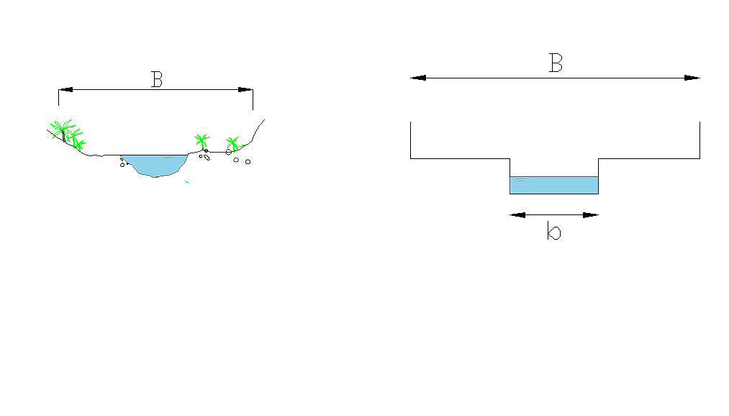

Typical Stream Cross Section
y: Water Depth
q: Unit Discharge
Notes:
4

Slide 5













Total Energy
Energy Line
Water surface.
Bed.
Reference Level
Notes:
5

Slide 6

Specific Energy
E
Notes:
6

Slide 7





Specific Energy
y
$$For q=0 y=E$$
$$y=E$$
q=cte
Mínimum
E
Notes:
7

Slide 8




Specific Energy
The minimum
Critical Depth
Critical Velocity
Celerity is defined as::
$$c=\sqrt{gy}→c=\sqrt{gy_{c}}$$
Notes:
8

Slide 9
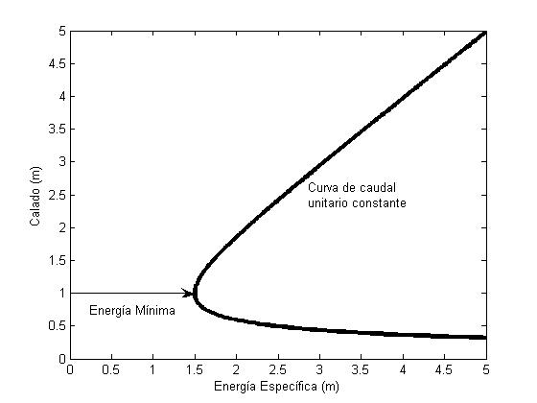
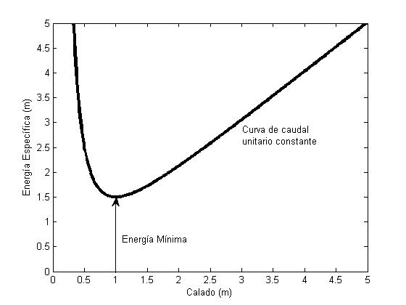
Specific Energy
Fork
Line of constant unit discharge
Line of constant unit discharge
Alternate Depths
Minimum energy
Minimum energy
Notes:
9

Slide 10


Froude Number
Froude is defined from the dominant forces. Inertial forces y Gravity forces
Notes:
10

Slide 11
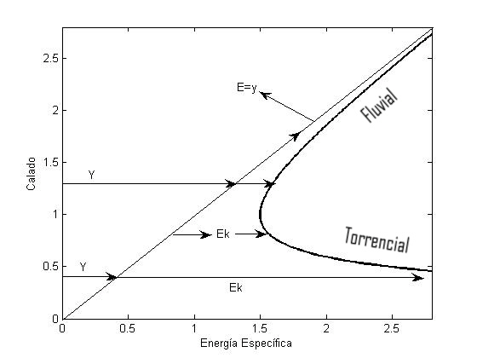
Flux Regime
Notes:
11

Slide 12


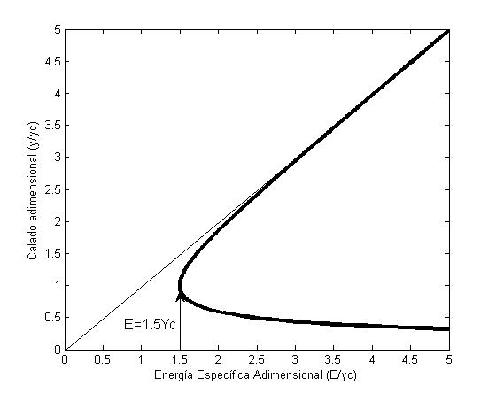
Dimensionless Specific Energy
Dimensionless depth
Dimensionless Specific Energy
Notes:
12

Slide 13
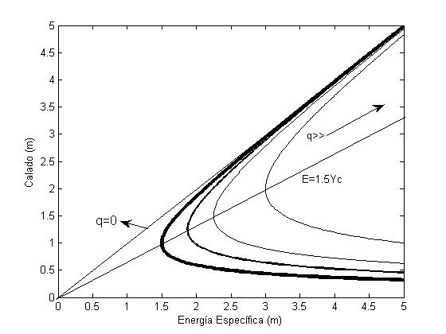




Specific Energy
Notes:
13

Slide 14





Specific energy & Froude
Notes:
14

Slide 15
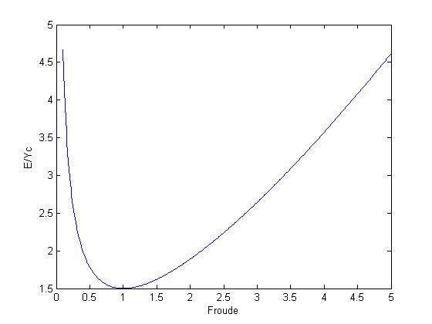
Dimensionless Energy Vs Froude
Notes:
15

Slide 16




Constant Specific energy Curves/ Unit Discharge curves
E
There Exists at least one minimum
q
Notes:
16

Slide 17
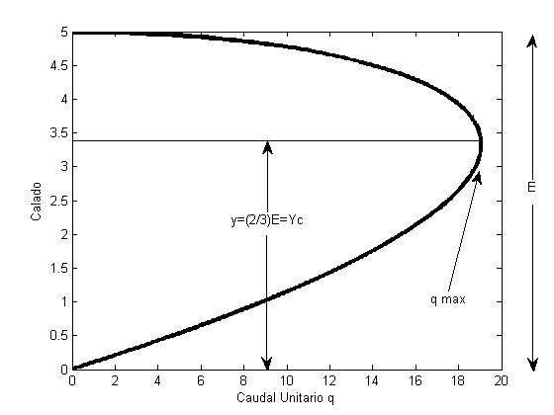

Unit Discharge Curve
q, Mínimo
Notes:
17

Slide 18
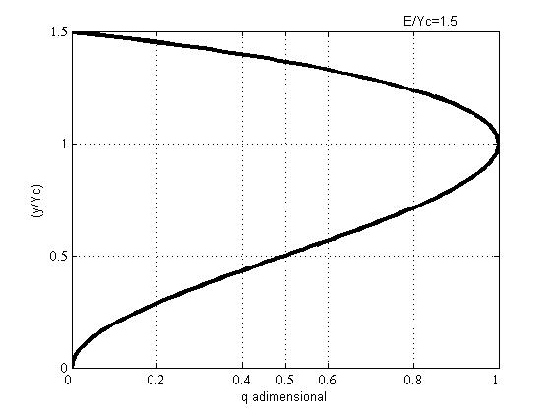
Dimensionless unit discharge.
q, Minimum
Notes:
18

Slide 19
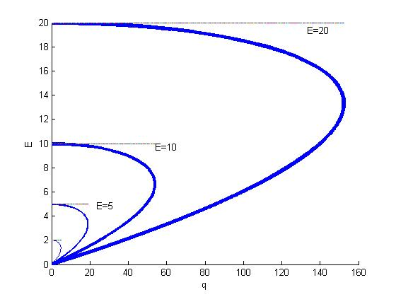
Energía especifica constante
Notes:
19

Slide 20
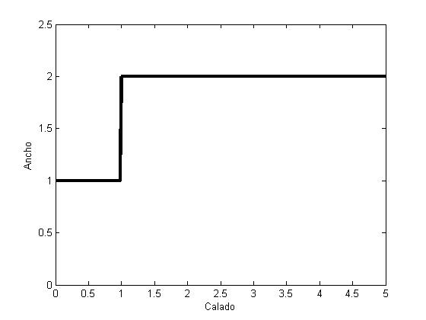
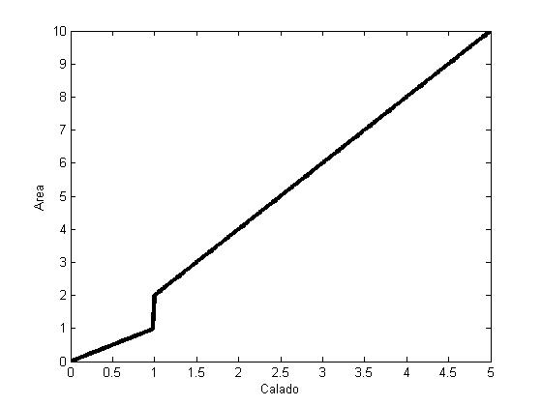
Relative minimum in a real section
Notes:
20

Slide 21
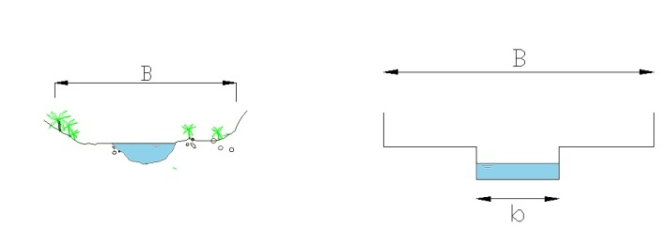
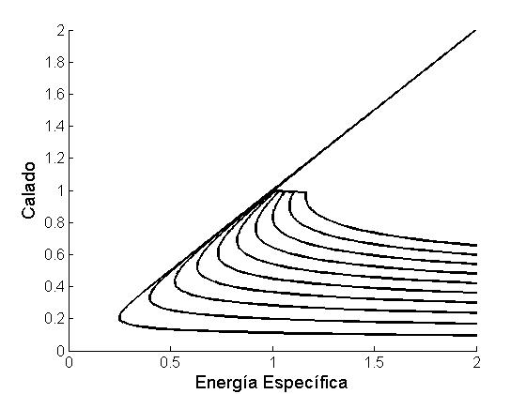
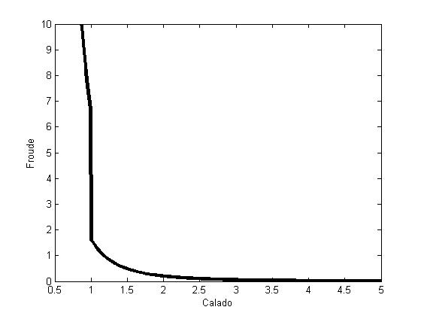
Relative minimum in a real section
More than one critical depth appears in a section
Notes:
21

Slide 22

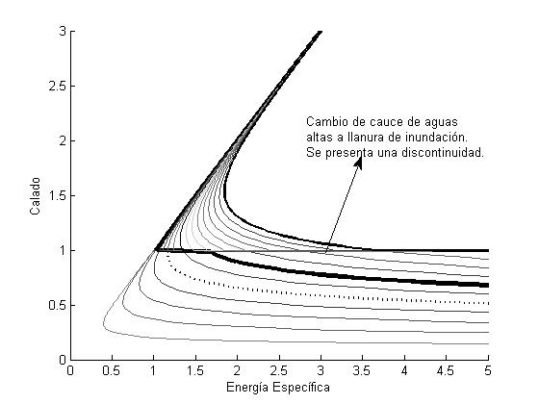
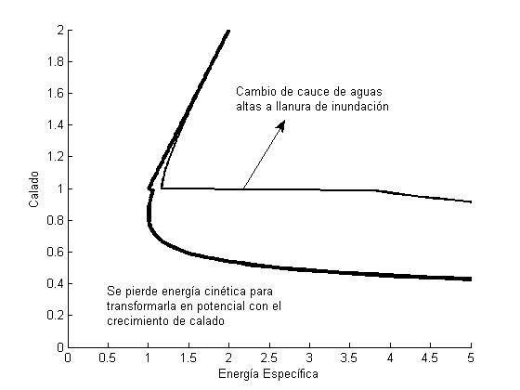
Los máximos relativos en una sección
Notes:
22

Slide 23
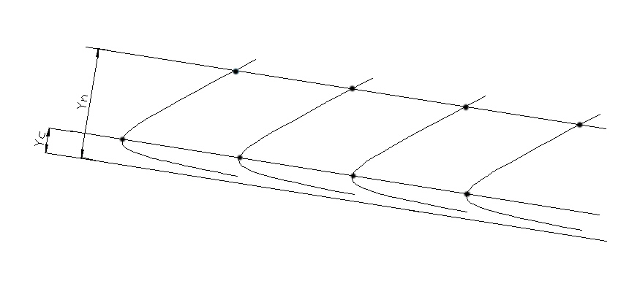
Critical and normal depth in a backwater curve
Notes:
23

Slide 24
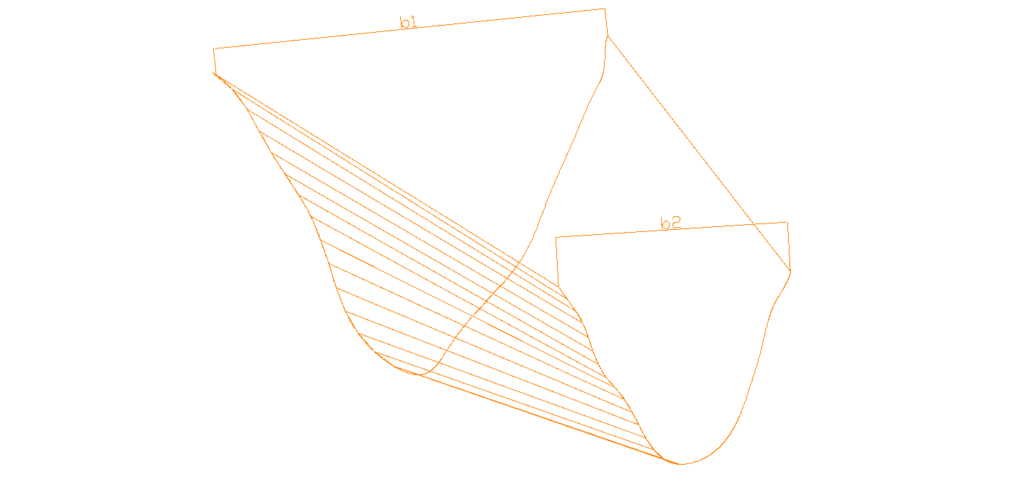

Narrowing & widening streams
A change in the width provokes a change in the unit discharge.
Notes:
24

Slide 25
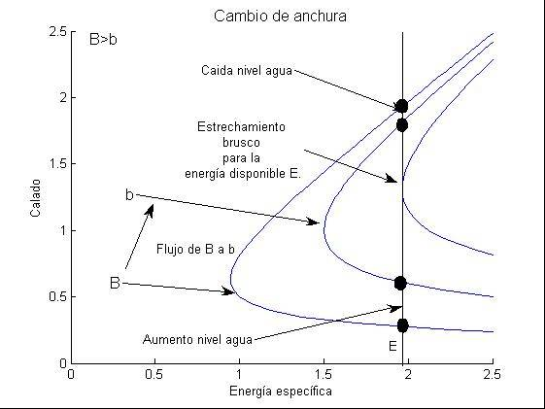
Narrowing/widening
Notes:
25

Slide 26







STEP
Notes:
26

Slide 27
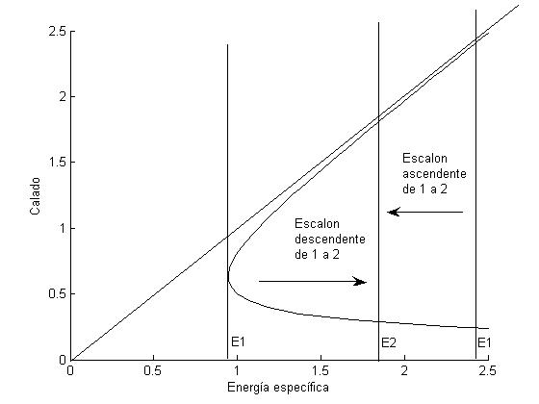


Step
Step up
Step Down
Notes:
27

Slide 28
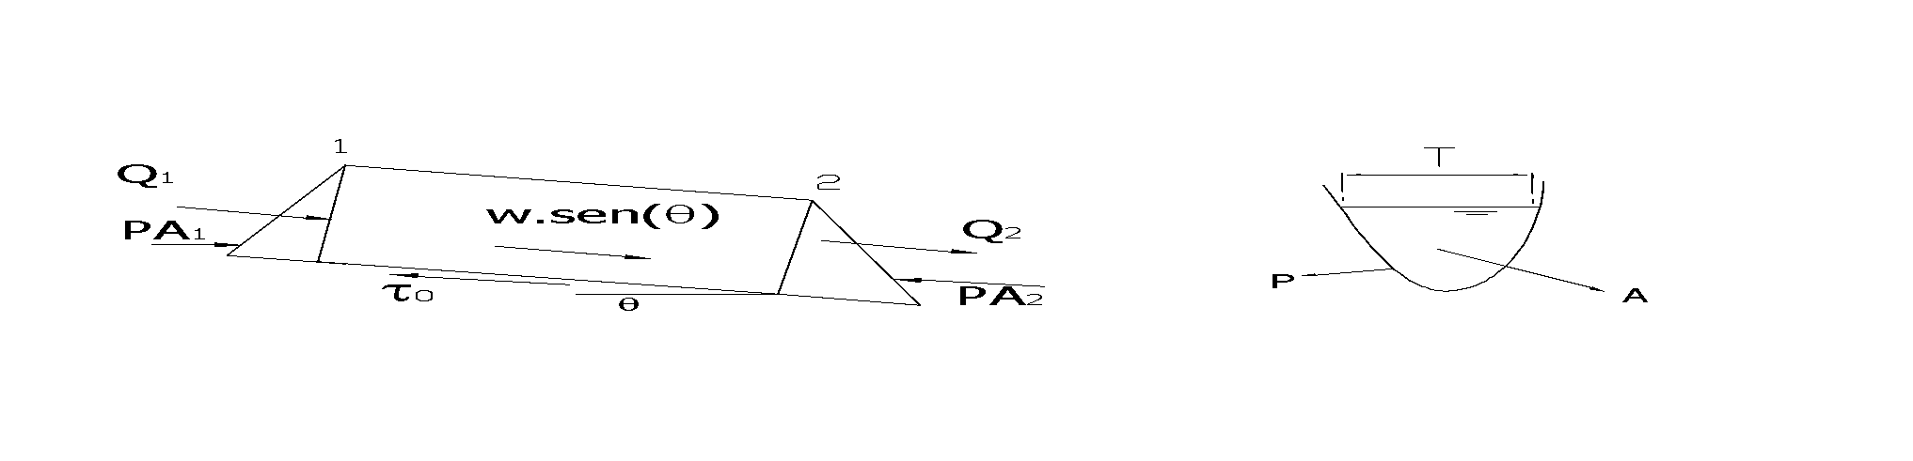
Specific Force
Equilibrium of forces In the control volume
Notes:
28

Slide 29
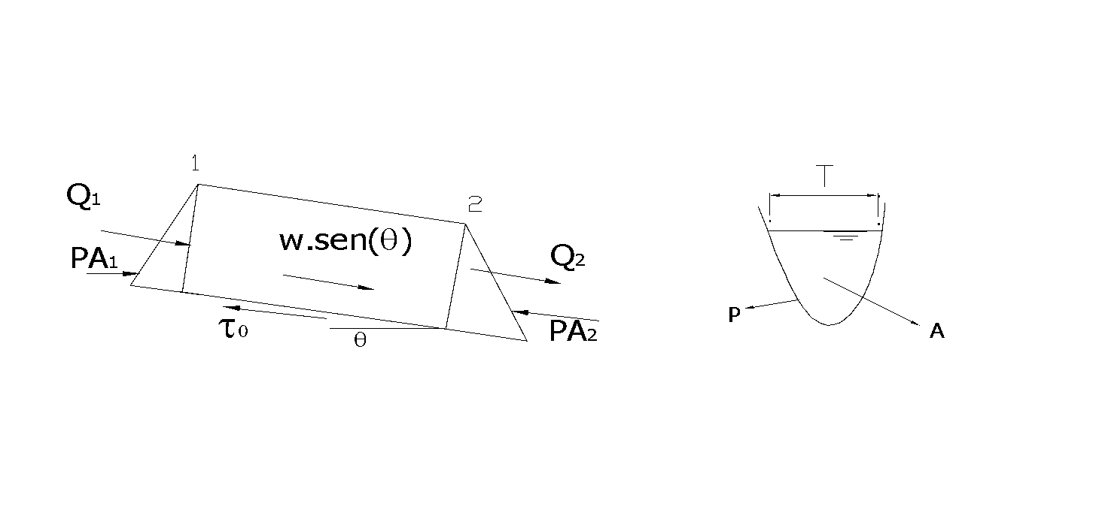

Specific Force
Notes:
29

Slide 30
Specific Force
Notes:
30

Slide 31
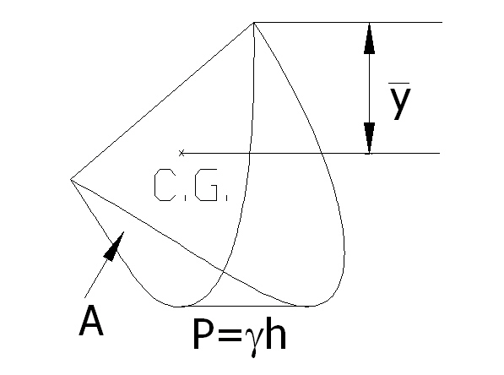
Pressure Force
Notes:
31

Slide 32
Specific Force
Rectangular Channel
Subsequent analysis
Notes:
32

Slide 33
Specific Force
q=0
h
M
Notes:
33

Slide 34
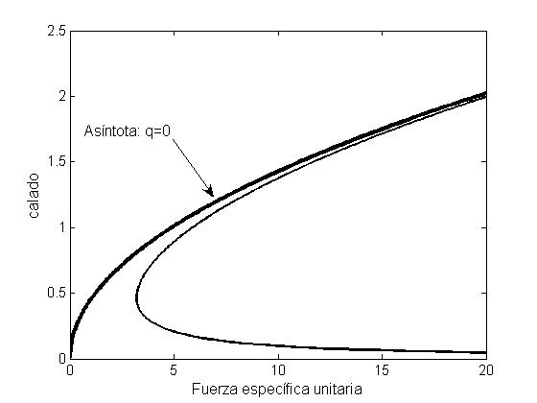

Specific Force
Depth
hc
Mmin
Unit Specific Force, Mu
Notes:
34

Slide 35

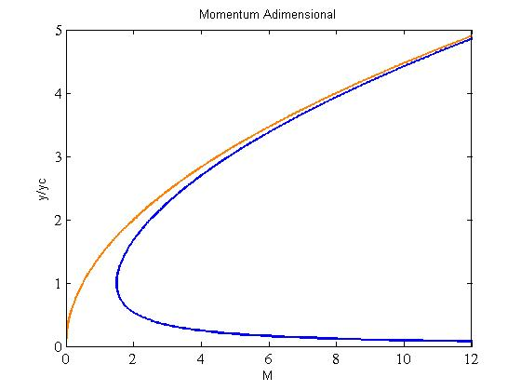
Specific Force
Dimensionless Momentum
Conjugated depth
Notes:
35

Slide 36
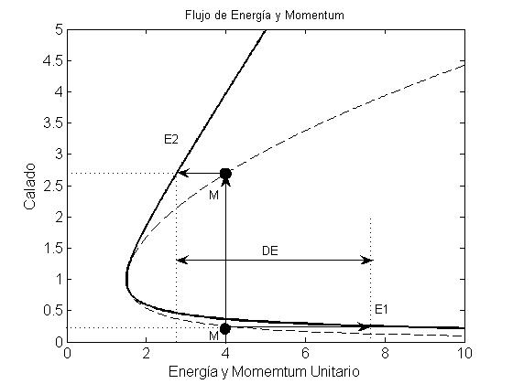


Alternate depths & conjugate depths
Depth
Energy & Dimensionless Momentum
Notes:
36

Slide 37

Hydraulic Jump
Specific force equilibrium
Dimensionless form
Belanger formula Rectangular channel
Notes:
37

Slide 38
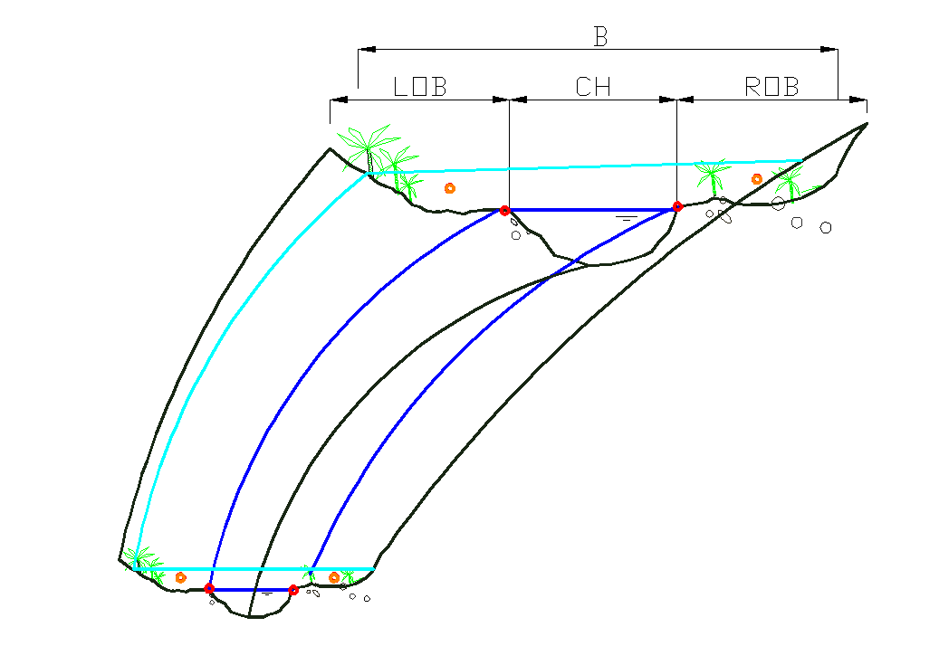

Ecuación energía del Hec-Ras
Notes:
38

Slide 39
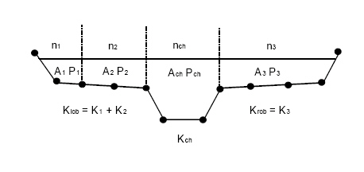

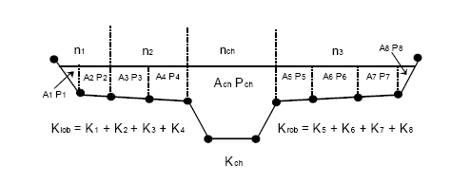
Flow resistance in Hec Ras
Notes:
39

Slide 40
Energy slope assesment
Mean Capacity
Energy slope aritmethic mean.
Energy slope geometric mean
Notes:
40

